Slide 1

The Link Layer
Computer Networks
Introduction to the Link Layer
Error-detection and -correction Techniques
Multiple Access Links and Protocols
Switched Local Area Networks
Link Virtualization: a Network as a Link Layer
Data Center Networking
Retrospective: A Day in the Life of a Web Page Request

Slide 2









Multiple access links, protocols
two types of “links”:
point-to-point
point-to-point link between Ethernet switch, host
PPP for dial-up access
broadcast (shared wire or medium)
old-school Ethernet
upstream HFC in cable-based access network
802.11 wireless LAN, 4G/4G. satellite
shared wire (e.g.,
cabled Ethernet)
shared radio: 4G/5G
shared radio: WiFi
shared radio: satellite
humans at a cocktail party
(shared air, acoustical)

Slide 3
Multiple access protocols
single shared broadcast channel
two or more simultaneous transmissions by nodes: interference
collision if node receives two or more signals at the same time
multiple access protocol
distributed algorithm that determines how nodes share channel, i.e., determine when node can transmit
communication about channel sharing must use channel itself!
no out-of-band channel for coordination

Slide 4
An ideal multiple access protocol
given: multiple access channel (MAC) of rate R bps
desiderate:
1. when one node wants to transmit, it can send at rate R.
2. when M nodes want to transmit, each can send at average rate R/M
3. fully decentralized:
no special node to coordinate transmissions
no synchronization of clocks, slots
4. simple

Slide 5
MAC protocols: taxonomy
three broad classes:
channel partitioning
divide channel into smaller “pieces” (time slots, frequency, code)
allocate piece to node for exclusive use
random access
channel not divided, allow collisions
“recover” from collisions
“taking turns”
nodes take turns, but nodes with more to send can take longer turns

Slide 6
Channel partitioning MAC protocols: TDMA
TDMA: time division multiple access
access to channel in “rounds”
each station gets fixed length slot (length = packet transmission time) in each round
unused slots go idle
example: 6-station LAN, 1,3,4 have packets to send, slots 2,5,6 idle
6-slot
frame
6-slot
frame
1
3
4
1
3
4

Slide 7
Channel partitioning MAC protocols: FDMA
FDMA: frequency division multiple access
channel spectrum divided into frequency bands
each station assigned fixed frequency band
unused transmission time in frequency bands go idle
example: 6-station LAN, 1,3,4 have packet to send, frequency bands 2,5,6 idle
time
frequency bands
FDM cable

Slide 8
Random access protocols
when node has packet to send
transmit at full channel data rate R
no a priori coordination among nodes
two or more transmitting nodes: “collision”
random access protocol specifies:
how to detect collisions
how to recover from collisions (e.g., via delayed retransmissions)
examples of random access MAC protocols:
ALOHA, slotted ALOHA
CSMA, CSMA/CD, CSMA/CA

Slide 9
Slotted ALOHA
assumptions:
all frames same size
time divided into equal size slots (time to transmit 1 frame)
nodes start to transmit only slot beginning
nodes are synchronized
if 2 or more nodes transmit in slot, all nodes detect collision
operation:
when node obtains fresh frame, transmits in next slot
if no collision: node can send new frame in next slot
if collision: node retransmits frame in each subsequent slot with probability p until success
randomization – why?

Slide 10
Slotted ALOHA
node 1
1
1
1
1
C: collision
S: success
E: empty
node 2
2
2
2
node 3
3
3
3
C
E
C
S
E
C
E
S
S
Pros:
single active node can continuously transmit at full rate of channel
highly decentralized: only slots in nodes need to be in sync
simple
Cons:
collisions, wasting slots
idle slots
nodes may be able to detect collision in less than time to transmit packet
clock synchronization

Slide 11

Slotted ALOHA: efficiency
efficiency: long-run fraction of successful slots (many nodes, all with many frames to send)
suppose: N nodes with many frames to send, each transmits in slot with probability p
prob that given node has success in a slot = p(1-p)^{N-1}
prob that any node has a success = Np(1-p)^{N-1}
max efficiency: find p* that maximizes Np(1-p)^{N-1}
for many nodes, take limit of Np*(1-p*)^{N-1} as N goes to infinity, gives:
max efficiency = 1/e = .37
at best: channel used for useful transmissions 37% of time!

Slide 12
Pure ALOHA
unslotted Aloha: simpler, no synchronization
when frame first arrives: transmit immediately
collision probability increases with no synchronization:
frame sent at t₀ collides with other frames sent in [t₀-1,t₀+1]
will overlap
with start of
i’s frame
will overlap
with end of
i’s frame
t₀ - 1
t₀
t₀ + 1
pure Aloha efficiency: 18% !

Slide 13
CSMA (carrier sense multiple access)
simple CSMA: listen before transmit:
if channel sensed idle: transmit entire frame
if channel sensed busy: defer transmission
human analogy: don’t interrupt others!
CSMA/CD: CSMA with collision detection
collisions detected within short time
colliding transmissions aborted, reducing channel wastage
collision detection easy in wired, difficult with wireless
human analogy: the polite conversationalist

Slide 14
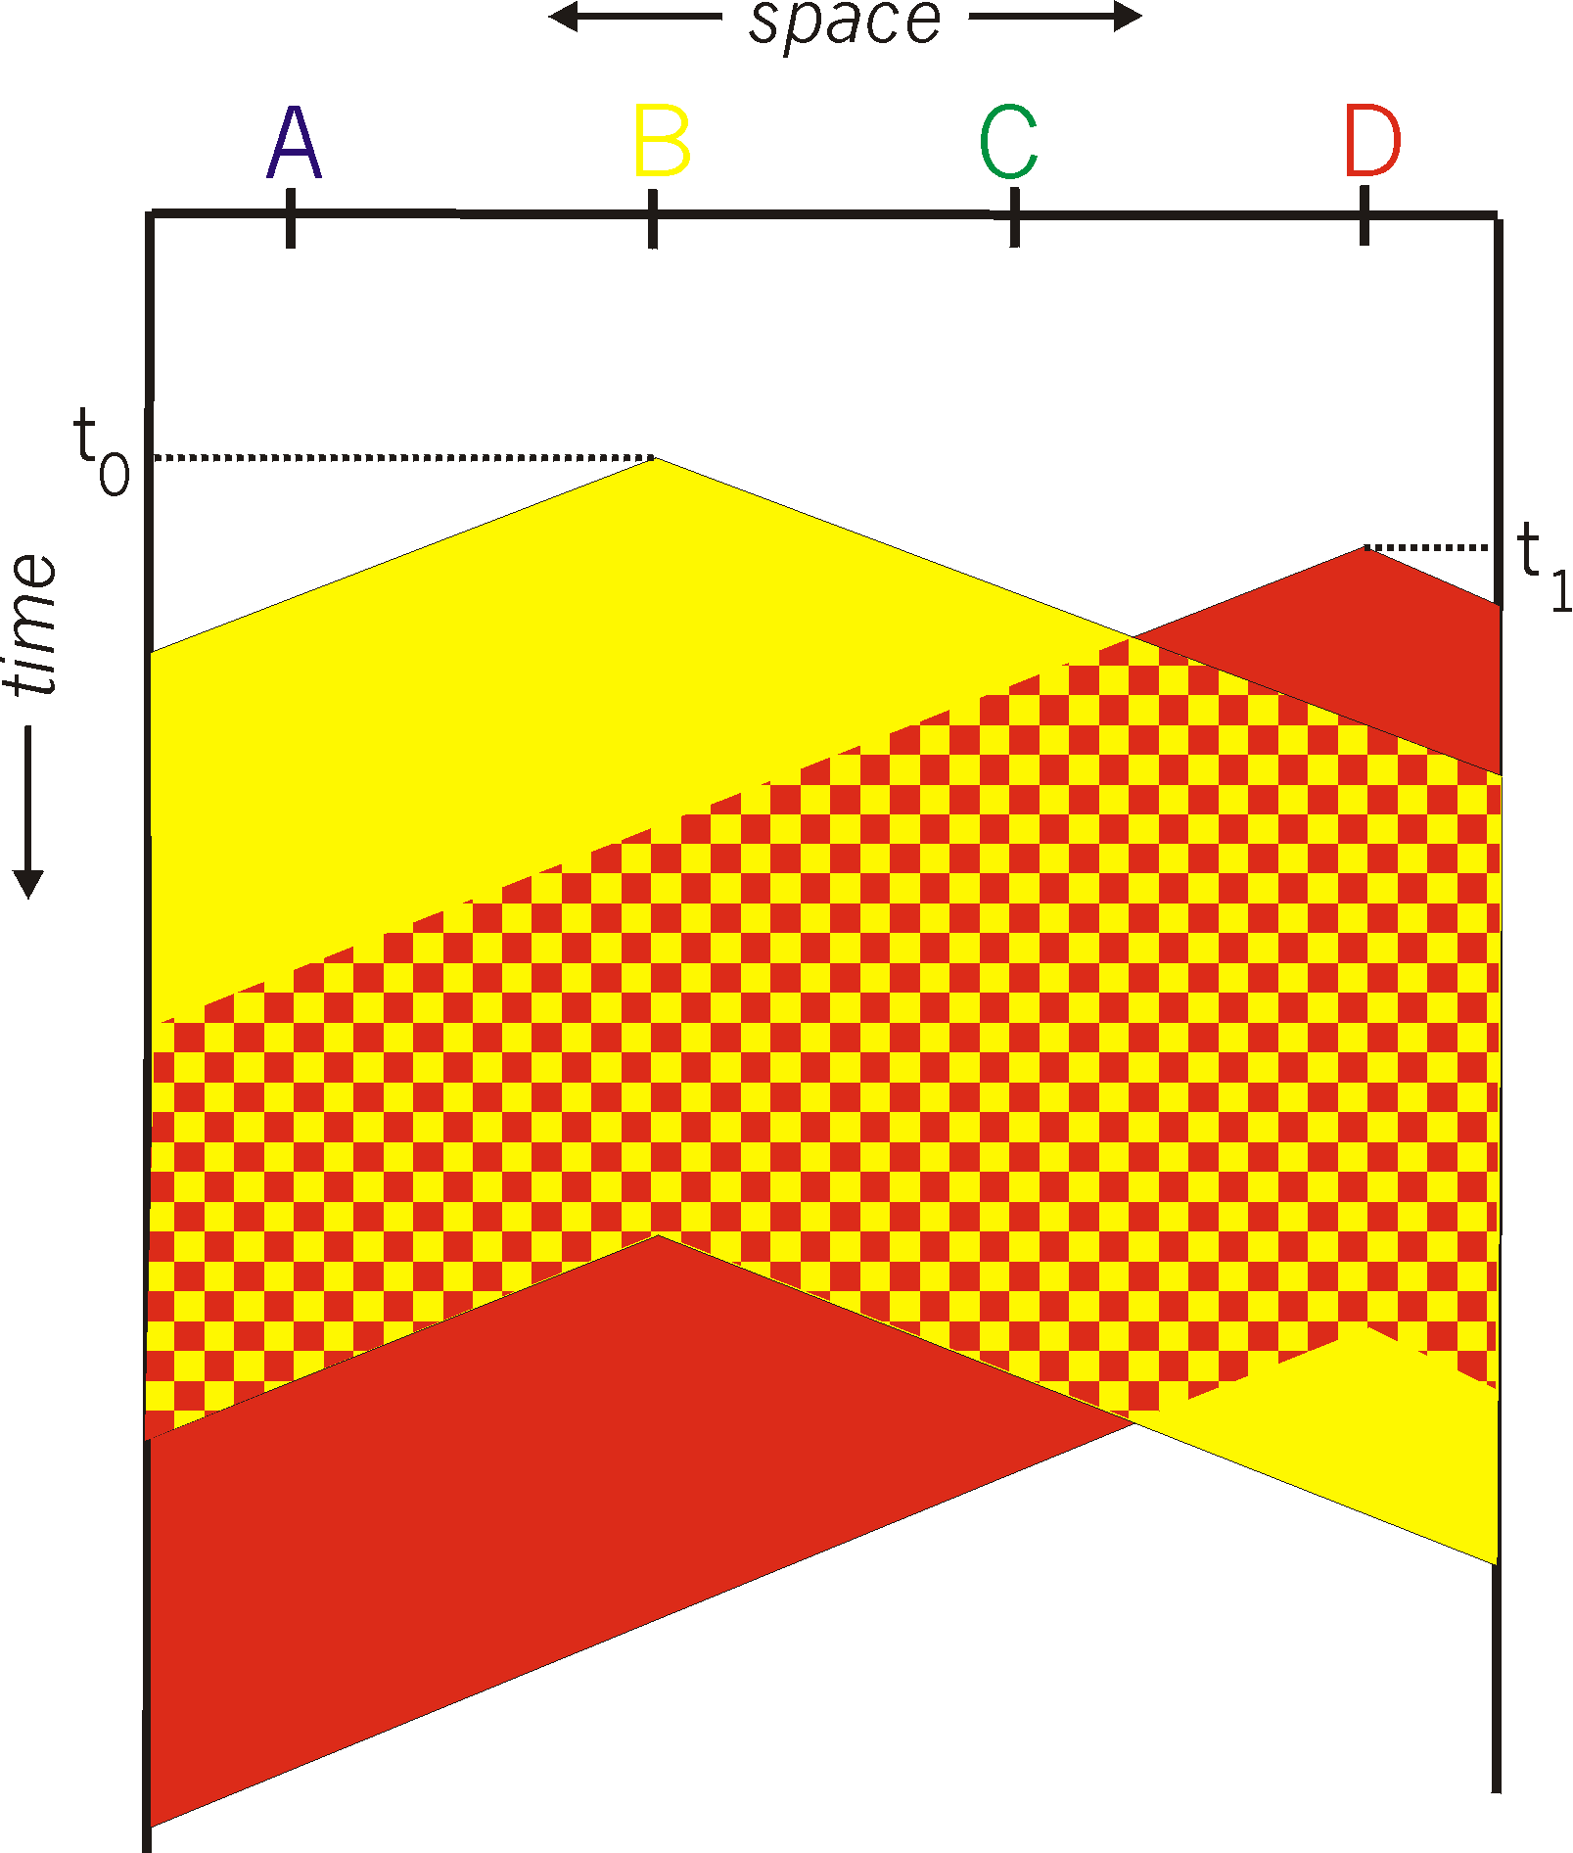
CSMA: collisions
spatial layout of nodes
collisions can still occur with carrier sensing:
propagation delay means two nodes may not hear each other’s just-started transmission
collision: entire packet transmission time wasted
distance & propagation delay play role in determining collision probability

Slide 15
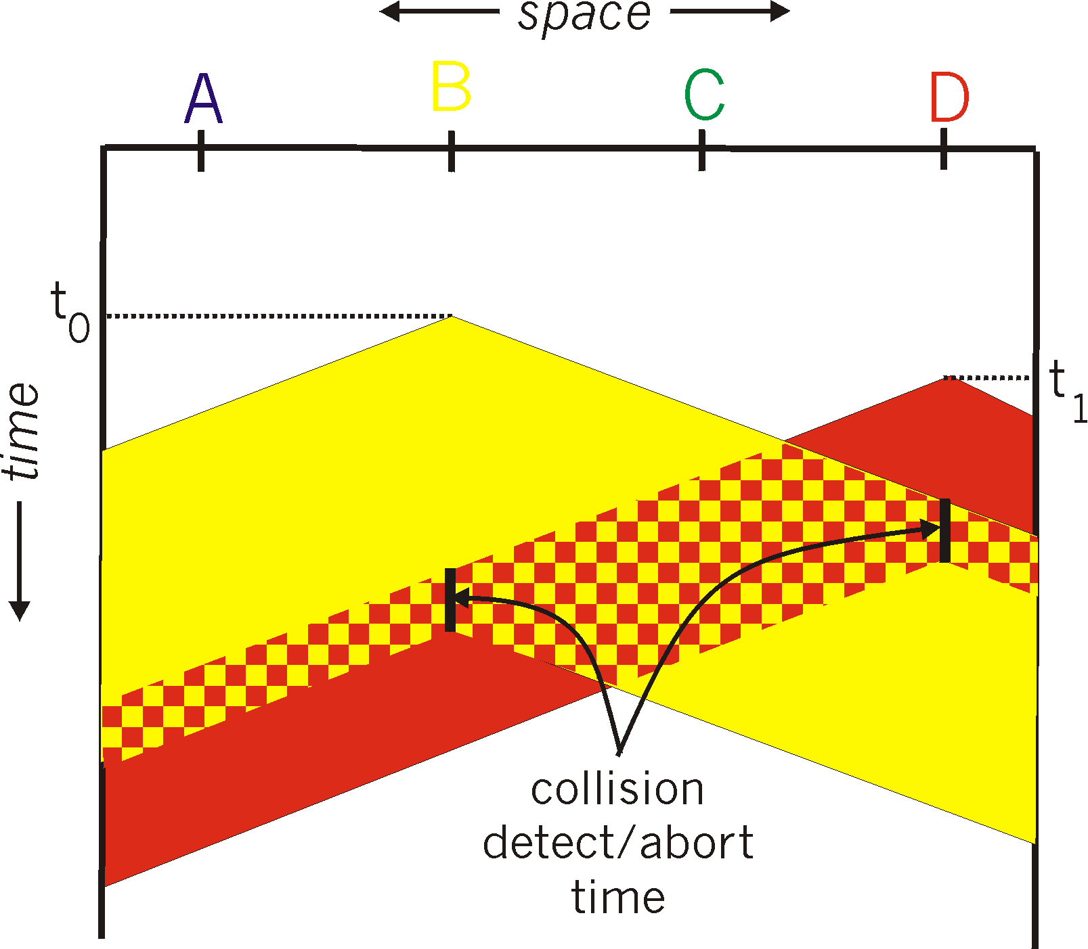
CSMA/CD:
spatial layout of nodes
CSMA/CD reduces the amount of time wasted in collisions
transmission aborted on collision detection

Slide 16
Ethernet CSMA/CD algorithm
Ethernet receives datagram from network layer, creates frame
If Ethernet senses channel:
if idle: start frame transmission.
if busy: wait until channel idle, then transmit
If entire frame transmitted without collision - done!
If another transmission detected while sending: abort, send jam signal
After aborting, enter binary (exponential) backoff:
after mth collision, chooses K at random from {0,1,2, …, 2^{m}-1}. Ethernet waits K·512 bit times, returns to Step 2
more collisions: longer backoff interval

Slide 17
CSMA/CD efficiency
T_{prop} = max prop delay between 2 nodes in LAN
t_{trans} = time to transmit max-size frame
efficiency goes to 1
as t_{prop} goes to 0
as t_{trans} goes to infinity
better performance than ALOHA: and simple, cheap, decentralized!

Slide 18
“Taking turns” MAC protocols
channel partitioning MAC protocols:
share channel efficiently and fairly at high load
inefficient at low load: delay in channel access, 1/N bandwidth allocated even if only 1 active node!
random access MAC protocols
efficient at low load: single node can fully utilize channel
high load: collision overhead
“taking turns” protocols
look for best of both worlds!

Slide 19

“Taking turns” MAC protocols
polling:
centralized controller “invites” other nodes to transmit in turn
typically used with “dumb” devices
concerns:
polling overhead
latency
single point of failure (master)
Bluetooth uses polling
data
poll
centralized controller
data
client devices

Slide 20
“Taking turns” MAC protocols
T
token passing:
control token message explicitly passed from one node to next, sequentially
transmit while holding token
concerns:
token overhead
latency
single point of failure (token)
(nothing
to send)
T
data

Slide 21
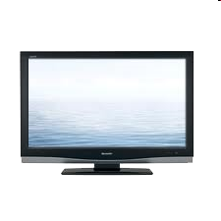


Cable access network: FDM, TDM and random access!
Internet frames, TV channels, control transmitted
downstream at different frequencies
cable headend
…
CMTS
…
splitter
cable
modem
ISP
cable modem
termination system
multiple downstream (broadcast) FDM channels: up to 1.6 Gbps/channel
single CMTS transmits into channels
multiple upstream channels (up to 1 Gbps/channel)
multiple access: all users contend (random access) for certain upstream channel time slots; others assigned TDM

Slide 22
Cable access network:
MAP frame for
Interval [t1, t2]
CMTS
Downstream channel i
Upstream channel j
cable headend
t₁
t₂
Residences with cable modems
Minislots containing
minislots request frames
Assigned minislots containing cable modem
upstream data frames
DOCSIS: Data Over Cable Service Interface Specification
FDM over upstream, downstream frequency channels
TDM upstream: some slots assigned, some have contention
downstream MAP frame: assigns upstream slots
request for upstream slots (and data) transmitted random access (binary backoff) in selected slots

Slide 23
Summary of MAC protocols
channel partitioning, by time, frequency or code
TDMA, FDMA
random access (dynamic),
ALOHA, S-ALOHA, CSMA, CSMA/CD
carrier sensing: easy in some technologies (wire), hard in others (wireless)
used in satellite, Ethernet, WiFi
taking turns
polling from central site, token passing
Bluetooth (token ring)

